Slide 1
RCANN – A ReConfigurable Artificial Neural Network for Iris Flower Classification
Matthew Griessler and Nick Landy

Slide 2
Agenda
Change from Proposal
Application Description
Implementation Requirements
Implementation Design
Project Status
Moving Forward

Slide 3
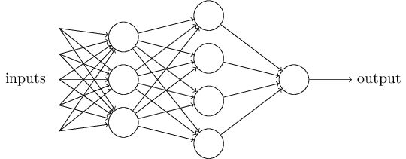
What is a Neural Network
Input Layer
Hidden Layer
Output Layer
Dataset | Input Layer | Hidden Layer | Output Layer
MNIST Handwriting | 784 | 15 | 10
Iris flower | 4 | 15 | 3

Slide 4
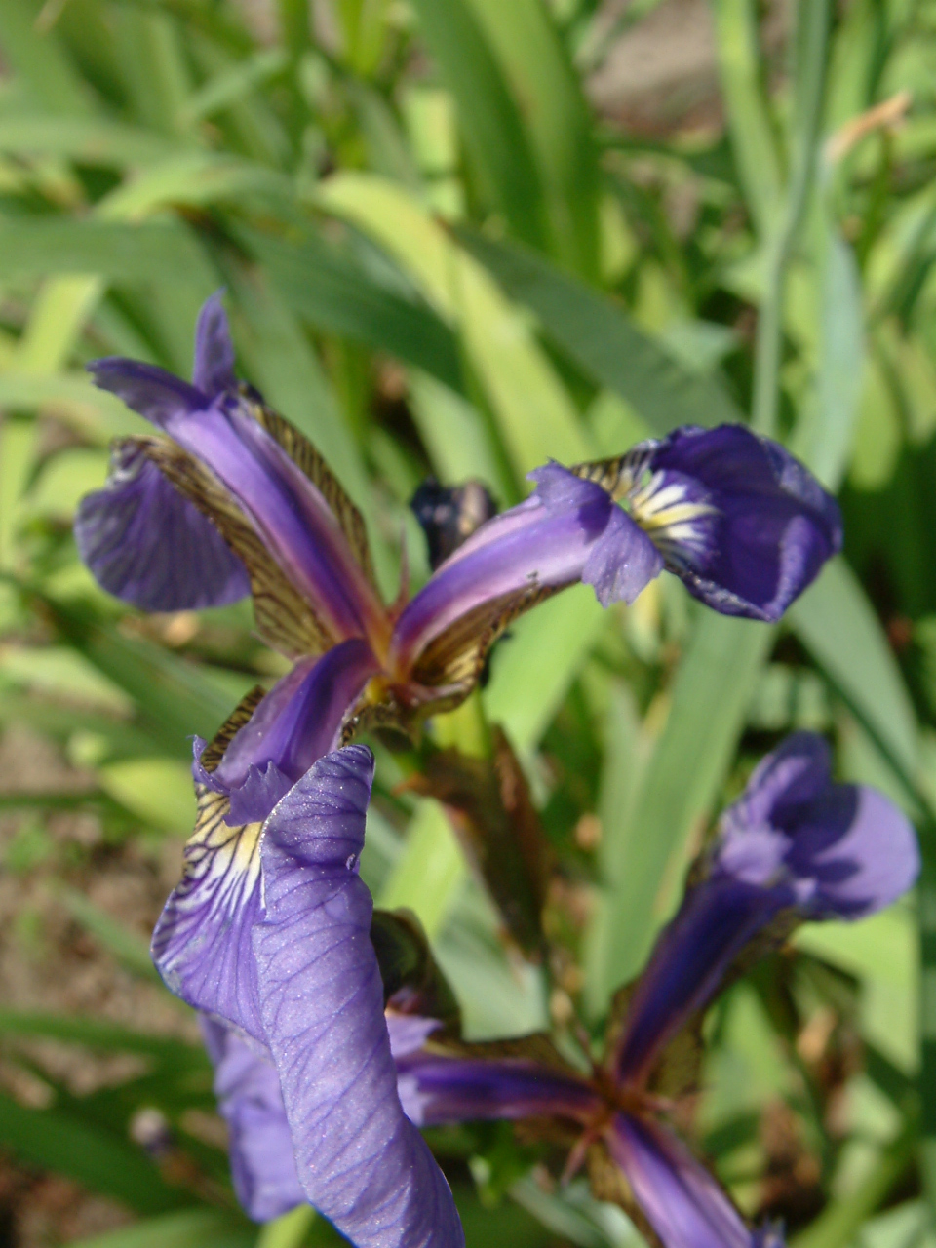
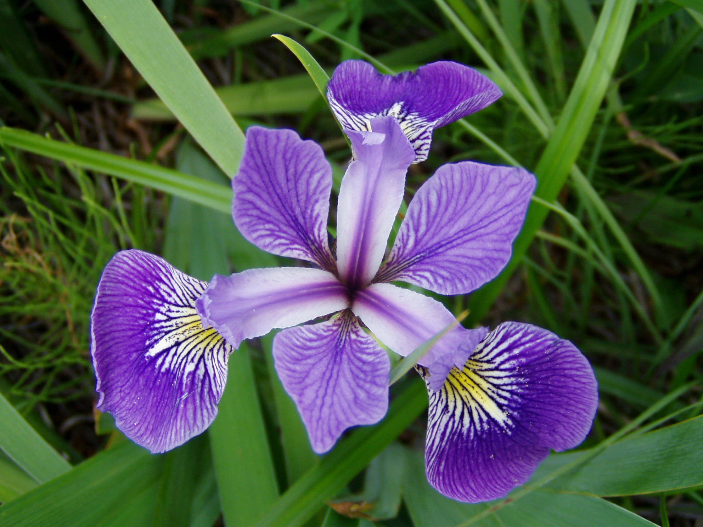
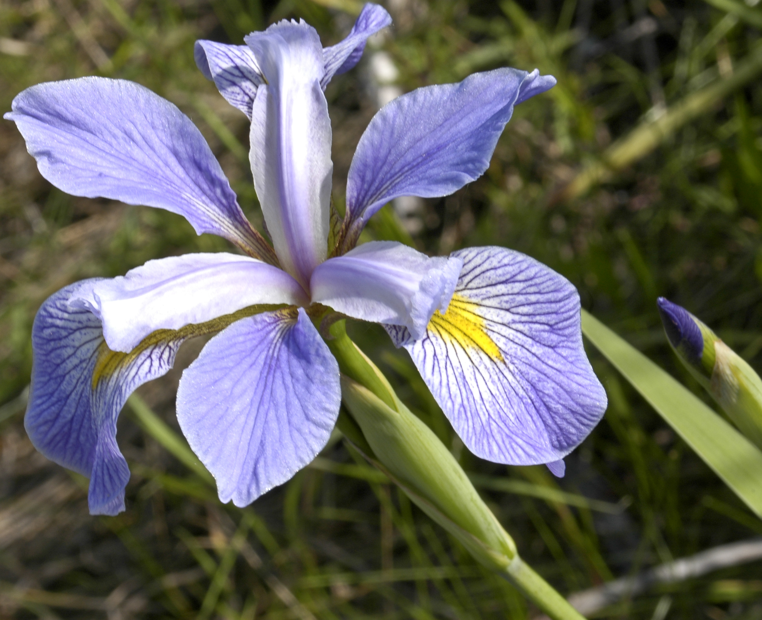
Changes from proposal
The MNIST design requires more MACs than available
We switched to a much simpler dataset, the iris data set
Iris setosa
Implications of changing datasets
Structure: Same
Required resources: Decreases
Iris versicolor
Dataset | Input Layer | Hidden Layer | Output Layer
MNIST Handwriting | 784 | 15 | 10
Iris flower | 4 | 15 | 3
Iris virginica

Slide 5
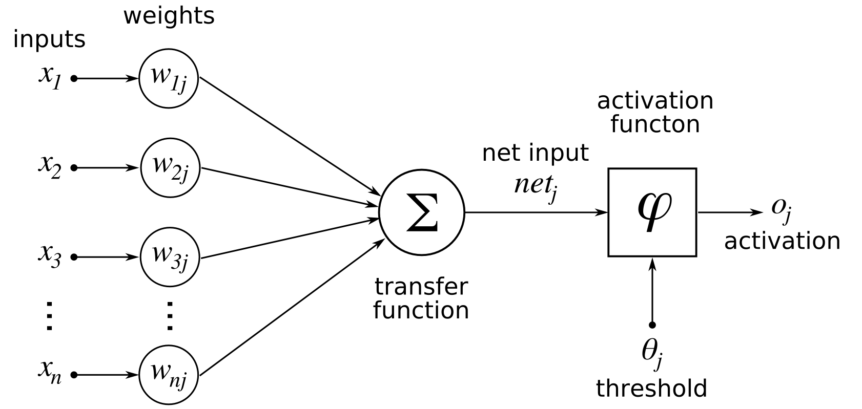
Neural Network - Node
It all starts with the node

Slide 6
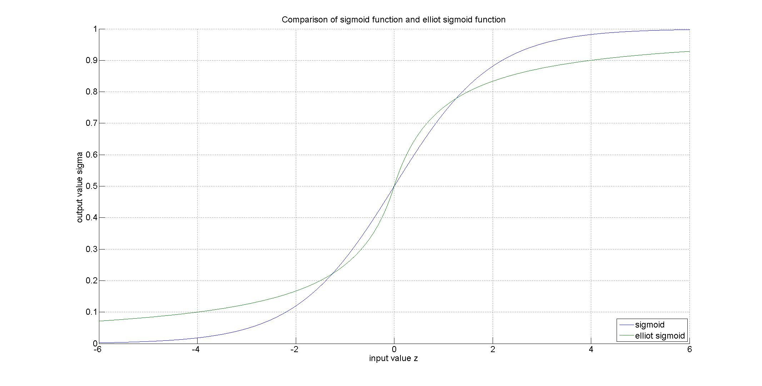
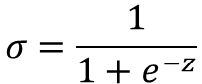
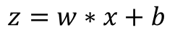
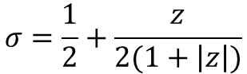
Neural Network – Activation Function
Sigmoid function
$$σ=\frac{1}{1+e^{−z}}$$
Elliot Sigmoid function
$$σ=\frac{1}{2}+\frac{z}{2(1+\left|z\right|)}$$
$$z=w∗x+b$$

Slide 7
Neural Network – Forward Pass
Process layers in order: first layer, hidden layer, output layer
Within a layer, nodes can be processed in parallel
Each node requires a multiply, accumulate, and activation function evaluation to get an output

Slide 8
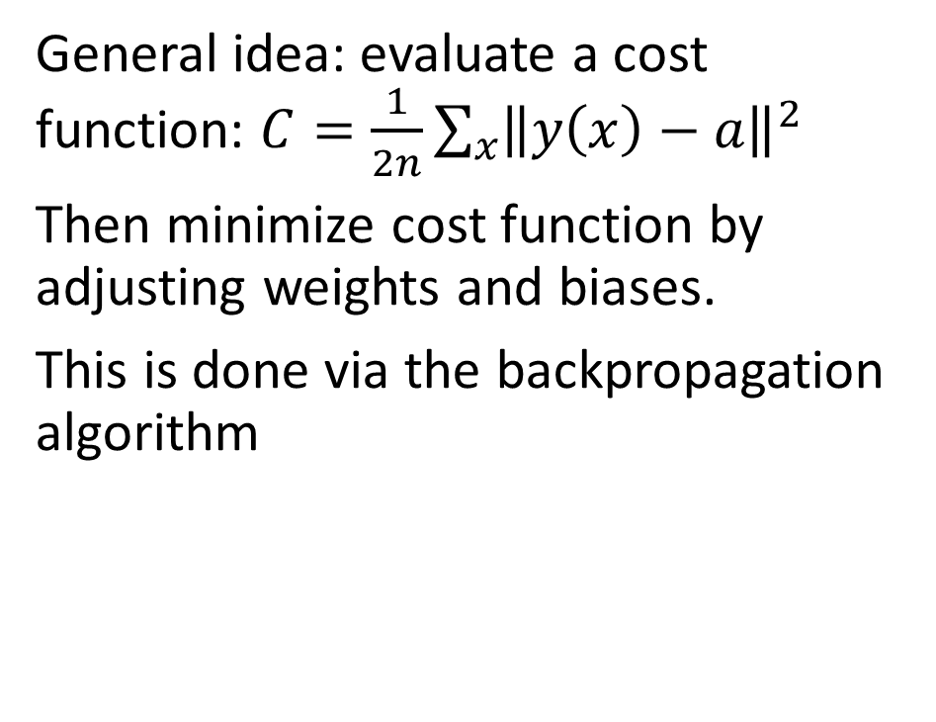
Neural Network - Backpropagation
General idea: evaluate a cost function: $C=\frac{1}{2n}\sum_{x}{{\left\|y\left(x\right)−a\right\|}^{2}}$
Then minimize cost function by adjusting weights and biases.
This is done via the backpropagation algorithm

Slide 9
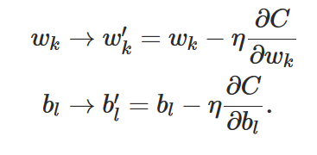
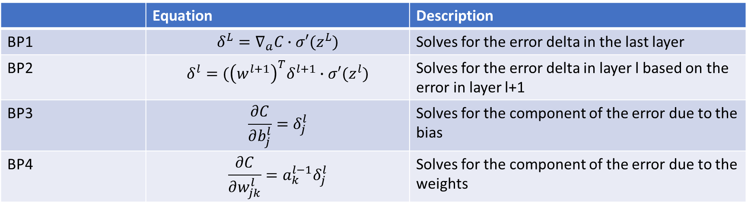
Neural Network - Backpropagation
 | Equation | Description
BP1 | $$δ^{L}=∇_{a}C∙σ′(z^{L})$$ | Solves for the error delta in the last layer
BP2 | $$δ^{l}=({\left(w^{l+1}\right)}^{T}δ^{l+1}∙σ′(z^{l})$$ | Solves for the error delta in layer l based on the error in layer l+1
BP3 | $$\frac{∂C}{∂b_{j}^{l}}=δ_{j}^{l}$$ | Solves for the component of the error due to the bias
BP4 | $$\frac{∂C}{∂w_{jk}^{l}}=a_{k}^{l−1}δ_{j}^{l}$$ | Solves for the component of the error due to the weights

Slide 10
Neural Network - Procedure
Neural network Use Procedure
Train for one epoch
Run verification
If performance is above threshold for accuracy (in our case 80%), go to step 4, otherwise, go back to step 1
Neural network is now ready for use with data where the answer isn’t known
Phase of Operation | Forward pass | Check Answer | Backpropagation
Training | Yes | Yes | Yes
Verification | Yes | Yes | No
Evaluation | Yes | No | No

Slide 11
Requirements
Req # | Requirement Description
General Requirements
G1 | Implement a neural network on an FPGA
G2 | Interface between FPGA and host computer
G3 | Demonstrate a speedup from implementation
G4 | Support training, verification, and evaluation
G5 | Support epoch and batch processing
Neural Network Requirements
N1 | Three layer network
N2 | Each layer can be configured with generic number of nodes
N3 | Implement forward pass, verification, and backpropagation
Forward Pass Requirements
F1 | Support pipe-lined and non-pipelined operation
F2 | Implement Elliot Sigmoid function for activation function
F3 | Take input from double buffered input memory
F4 | Put output into double buffered output memory
Verification Requirements
V1 | Check output against expected answer stored in double buffered memory
Backpropagation Requirements
B1 | Implement backpropagation equation BP1
B2 | Implement backpropagation equation BP2
B3 | Implement backpropagation equation BP3
B4 | Implement backpropagation equation BP4
B5 | Update node layer-layer weights
B6 | Update node biases

Slide 12
Implementation

Slide 13
Memory Map

Slide 14
Double Buffered Memory

Slide 15
Memory Allocation
Type | Name | Size (Length x Width)
Datapath Input Memory | Input 0 (Sepia Width) | BatchSize X InputSize
Datapath Input Memory | Input 1 (Sepia Length) | BatchSize X InputSize
Datapath Input Memory | Input 2 (Petal Width) | BatchSize X InputSize
Datapath Input Memory | Input 3 (Petal Length) | BatchSize X InputSize
Datapath Input Memory | Expected Result | BatchSize X NumOutputs
Datapath Output Memory | Calculated Result | BatchSize X NumOutputs

Slide 16
Block Diagram (Forward Pass)
Input[3:0]
Clk
D
Q
D
Q
D
Q
D
Q
Cntrl
a1[3:0]
Clk
a1[3:0]
a1[3:0]
...
Cntrl
W2[0][3:0]
MAC
W2[1][3:0]
MAC
W2[14:0][3:0]
b2[14:0]
b2[0]
b2[1]
a2[0]
a2[1]
σ
σ'2[0]
σ
σ'2[1]
a2[14:0]
σ'2[14:0]
Clk
a2[14:0]
a2[14:0]
a2[14:0]
Cntrl
W3[0][14:0]
MAC
W3[1][14:0]
MAC
W3[2][14:0]
MAC
W3[2:0][14:0]
b3[0]
b3[1]
b3[2]
b3[2:0]
a3[0]
a3[1]
a3[2]
σ
σ'3[0]
σ
σ'3[1]
σ
σ'3[2]
a3[2:0]
σ'3[2:0]

Slide 17
Block Diagram (Error Calculation)
δ3[2:0]
δ3[2:0]
Clk
MAC
MAC
...
W3[2:0][0]
W3[2:0][1]
Cntrl
δ3[2:0]
*
σ'2[0]
*
σ'2[1]
σ'2[14:0]
W3[2:0][14:0]
δ2[0]
δ2[1]
δ2[14:0]
-
-
-
a3[0]
+
y[0]
a3[1]
+
y[1]
a3[2]
+
y[2]
Clk
Cntrl
a3[2:0]
σ'3[0]
σ'3[1]
*
*
*
σ'3[2]
σ'3[2:0]
y[2:0]
δ3[0]
δ3[1]
δ3[2]
δ3[2:0]

Slide 18
Block Diagram (W and b updates)
Clk
*
a1[2]
δ2[13]
Cntrl
δ2[13]
*
-n
*
-n
...
...
+
+
a1[2:0]
δ3[14:0]
n
D
Q
D
Q
b[1][13]
w[2][13]
b2[14:0]
W2[14:0][3:0]

Slide 19
Project Status
All outstanding questions answered
Will the design fit?
Host to accelerator communication?
All project components have been designed
Currently implementing components in HDL and testing them

Slide 20
Moving Forward
Finish component implementation
Put components together to build neural network and host to accelerator interface
Demonstrate speedup using accelerator (FPGA)

Slide 21
Demo Plan
Will run training using both software and FPGA implementation on host and compare time to complete each
Will calculate speedup
Will also compare accuracy of software and FPGA implementation
We will also try to show effects of # of hidden layer nodes on speedup and accuracy

Slide 22
Backup Slides

Slide 23
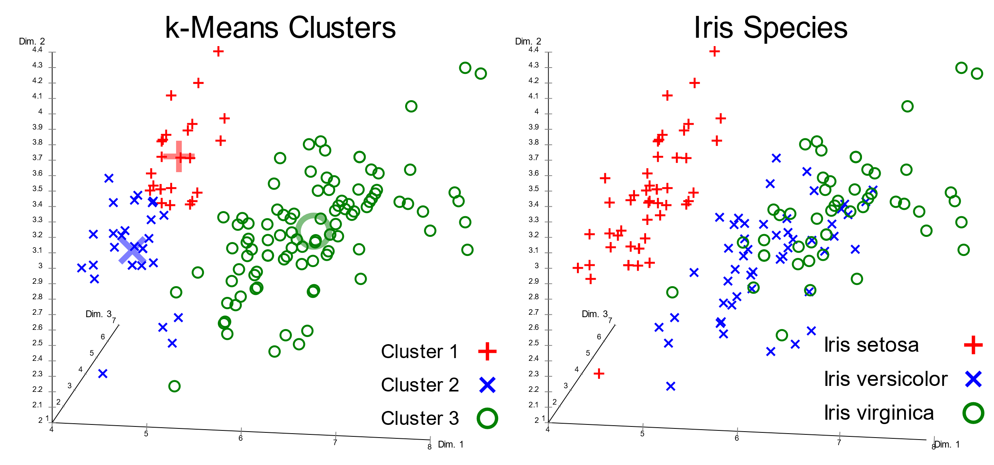
Why Iris?

Slide 24
Double Buffer Switch

Slide 25
Datapath Memory Input

